Slide 1
Chapter 17 Component-based software engineering
Lecture 1

Slide 2
Topics covered
Components and component models
CBSE processes
Component composition

Slide 3
Component-based development
Component-based software engineering (CBSE) is an approach to software development that relies on the reuse of entities called ‘software components’.
It emerged from the failure of object-oriented development to support effective reuse. Single object classes are too detailed and specific.
Components are more abstract than object classes and can be considered to be stand-alone service providers. They can exist as stand-alone entities.

Slide 4
CBSE essentials
Independent components specified by their interfaces.
Component standards to facilitate component integration.
Middleware that provides support for component inter-operability.
A development process that is geared to reuse.

Slide 5
CBSE and design principles
Apart from the benefits of reuse, CBSE is based on sound software engineering design principles:
Components are independent so do not interfere with each other;
Component implementations are hidden;
Communication is through well-defined interfaces;
Component platforms are shared and reduce development costs.

Slide 6
Component standards
Standards need to be established so that components can communicate with each other and inter-operate.
Unfortunately, several competing component standards were established:
Sun’s Enterprise Java Beans
Microsoft’s COM and .NET
CORBA’s CCM
In practice, these multiple standards have hindered the uptake of CBSE. It is impossible for components developed using different approaches to work together.

Slide 7
CBSE problems
Component trustworthiness - how can a component with no available source code be trusted?
Component certification - who will certify the quality of components?
Emergent property prediction - how can the emergent properties of component compositions be predicted?
Requirements trade-offs - how do we do trade-off analysis between the features of one component and another?

Slide 8
Components
Components provide a service without regard to where the component is executing or its programming language
A component is an independent executable entity that can be made up of one or more executable objects;
The component interface is published and all interactions are through the published interface;

Slide 9
Component definitions
Councill and Heinmann:
A software component is a software element that conforms to a component model and can be independently deployed and composed without modification according to a composition standard.
Szyperski:
A software component is a unit of composition with contractually specified interfaces and explicit context dependencies only. A software component can be deployed independently and is subject to composition by third-parties.

Slide 10
Component characteristics
Component characteristic | Description
Standardized | Component standardization means that a component used in a CBSE process has to conform to a standard component model. This model may define component interfaces, component metadata, documentation, composition, and deployment.
Independent | A component should be independent—it should be possible to compose and deploy it without having to use other specific components. In situations where the component needs externally provided services, these should be explicitly set out in a ‘requires’ interface specification.
Composable | For a component to be composable, all external interactions must take place through publicly defined interfaces. In addition, it must provide external access to information about itself, such as its methods and attributes.

Slide 11
Component characteristics
Component characteristic | Description
Deployable | To be deployable, a component has to be self-contained. It must be able to operate as a stand-alone entity on a component platform that provides an implementation of the component model. This usually means that the component is binary and does not have to be compiled before it is deployed. If a component is implemented as a service, it does not have to be deployed by a user of a component. Rather, it is deployed by the service provider.
Documented | Components have to be fully documented so that potential users can decide whether or not the components meet their needs. The syntax and, ideally, the semantics of all component interfaces should be specified.

Slide 12
Component as a service provider
The component is an independent, executable entity. It does not have to be compiled before it is used with other components.
The services offered by a component are made available through an interface and all component interactions take place through that interface.
The component interface is expressed in terms of parameterized operations and its internal state is never exposed.

Slide 13
Component interfaces
Provides interface
Defines the services that are provided by the component to other components.
This interface, essentially, is the component API. It defines the methods that can be called by a user of the component.
Requires interface
Defines the services that specifies what services must be made available for the component to execute as specified.
This does not compromise the independence or deployability of a component because the ‘requires’ interface does not define how these services should be provided.

Slide 14

Component interfaces
Note UML notation. Ball and sockets can fit together.

Slide 15
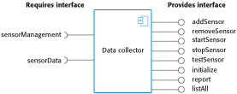
A model of a data collector component

Slide 16
Component models
A component model is a definition of standards for component implementation, documentation and deployment.
Examples of component models
EJB model (Enterprise Java Beans)
COM+ model (.NET model)
Corba Component Model
The component model specifies how interfaces should be defined and the elements that should be included in an interface definition.

Slide 17
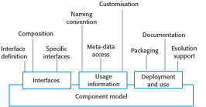
Basic elements of a component model

Slide 18
Elements of a component model
Interfaces
Components are defined by specifying their interfaces. The component model specifies how the interfaces should be defined and the elements, such as operation names, parameters and exceptions, which should be included in the interface definition.
Usage
In order for components to be distributed and accessed remotely, they need to have a unique name or handle associated with them. This has to be globally unique.
Deployment
The component model includes a specification of how components should be packaged for deployment as independent, executable entities.

Slide 19
Middleware support
Component models are the basis for middleware that provides support for executing components.
Component model implementations provide:
Platform services that allow components written according to the model to communicate;
Support services that are application-independent services used by different components.
To use services provided by a model, components are deployed in a container. This is a set of interfaces used to access the service implementations.

Slide 20
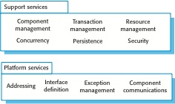
Middleware services defined in a component model

Slide 21
CBSE processes
CBSE processes are software processes that support component-based software engineering.
They take into account the possibilities of reuse and the different process activities involved in developing and using reusable components.
Development for reuse
This process is concerned with developing components or services that will be reused in other applications. It usually involves generalizing existing components.
Development with reuse
This process is the process of developing new applications using existing components and services.

Slide 22
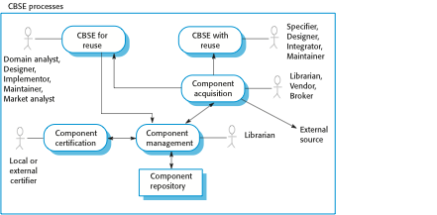
CBSE processes

Slide 23
Supporting processes
Component acquisition is the process of acquiring components for reuse or development into a reusable component.
It may involve accessing locally- developed components or services or finding these components from an external source.
Component management is concerned with managing a company’s reusable components, ensuring that they are properly catalogued, stored and made available for reuse.
Component certification is the process of checking a component and certifying that it meets its specification.

Slide 24
Key points
CBSE is a reuse-based approach to defining and implementing loosely coupled components into systems.
A component is a software unit whose functionality and dependencies are completely defined by its interfaces.
A component model defines a set of standards that component providers and composers should follow.
The key CBSE processes are CBSE for reuse and CBSE with reuse.

Slide 25
Chapter 17 Component-based software engineering
Lecture 2

Slide 26
CBSE for reuse
CBSE for reuse focuses on component development.
Components developed for a specific application usually have to be generalised to make them reusable.
A component is most likely to be reusable if it associated with a stable domain abstraction (business object).
For example, in a hospital stable domain abstractions are associated with the fundamental purpose - nurses, patients, treatments, etc.

Slide 27
Component development for reuse
Components for reuse may be specially constructed by generalising existing components.
Component reusability
Should reflect stable domain abstractions;
Should hide state representation;
Should be as independent as possible;
Should publish exceptions through the component interface.
There is a trade-off between reusability and usability
The more general the interface, the greater the reusability but it is then more complex and hence less usable.

Slide 28
Changes for reusability
Remove application-specific methods.
Change names to make them general.
Add methods to broaden coverage.
Make exception handling consistent.
Add a configuration interface for component adaptation.
Integrate required components to reduce dependencies.

Slide 29
Exception handling
Components should not handle exceptions themselves, because each application will have its own requirements for exception handling.
Rather, the component should define what exceptions can arise and should publish these as part of the interface.
In practice, however, there are two problems with this:
Publishing all exceptions leads to bloated interfaces that are harder to understand. This may put off potential users of the component.
The operation of the component may depend on local exception handling, and changing this may have serious implications for the functionality of the component.

Slide 30
Legacy system components
Existing legacy systems that fulfil a useful business function can be re-packaged as components for reuse.
This involves writing a wrapper component that implements provides and requires interfaces then accesses the legacy system.
Although costly, this can be much less expensive than rewriting the legacy system.

Slide 31
Reusable components
The development cost of reusable components may be higher than the cost of specific equivalents. This extra reusability enhancement cost should be an organization rather than a project cost.
Generic components may be less space-efficient and may have longer execution times than their specific equivalents.

Slide 32
Component management
Component management involves deciding how to classify the component so that it can be discovered, making the component available either in a repository or as a service, maintaining information about the use of the component and keeping track of different component versions.
A company with a reuse program may carry out some form of component certification before the component is made available for reuse.
Certification means that someone apart from the developer checks the quality of the component.

Slide 33
CBSE with reuse
CBSE with reuse process has to find and integrate reusable components.
When reusing components, it is essential to make trade-offs between ideal requirements and the services actually provided by available components.
This involves:
Developing outline requirements;
Searching for components then modifying requirements according to available functionality.
Searching again to find if there are better components that meet the revised requirements.
Composing components to create the system.

Slide 34
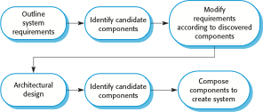
CBSE with reuse

Slide 35

The component identification process

Slide 36
Component identification issues
Trust. You need to be able to trust the supplier of a component. At best, an untrusted component may not operate as advertised; at worst, it can breach your security.
Requirements. Different groups of components will satisfy different requirements.
Validation.
The component specification may not be detailed enough to allow comprehensive tests to be developed.
Components may have unwanted functionality. How can you test this will not interfere with your application?

Slide 37
Component validation
Component validation involves developing a set of test cases for a component (or, possibly, extending test cases supplied with that component) and developing a test harness to run component tests.
The major problem with component validation is that the component specification may not be sufficiently detailed to allow you to develop a complete set of component tests.
As well as testing that a component for reuse does what you require, you may also have to check that the component does not include any malicious code or functionality that you don’t need.

Slide 38
Ariane launcher failure – validation failure?
In 1996, the 1st test flight of the Ariane 5 rocket ended in disaster when the launcher went out of control 37 seconds after take off.
The problem was due to a reused component from a previous version of the launcher (the Inertial Navigation System) that failed because assumptions made when that component was developed did not hold for Ariane 5.
The functionality that failed in this component was not required in Ariane 5.

Slide 39
Component composition
The process of assembling components to create a system.
Composition involves integrating components with each other and with the component infrastructure.
Normally you have to write ‘glue code’ to integrate components.

Slide 40
Types of composition
Sequential composition where the composed components are executed in sequence. This involves composing the provides interfaces of each component.
Hierarchical composition where one component calls on the services of another. The provides interface of one component is composed with the requires interface of another.
Additive composition where the interfaces of two components are put together to create a new component. Provides and requires interfaces of integrated component is a combination of interfaces of constituent components.

Slide 41
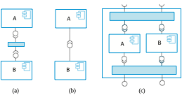
Types of component composition

Slide 42
Interface incompatibility
Parameter incompatibility where operations have the same name but are of different types.
Operation incompatibility where the names of operations in the composed interfaces are different.
Operation incompleteness where the provides interface of one component is a subset of the requires interface of another.

Slide 43
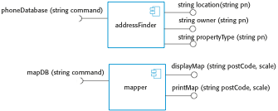
Components with incompatible interfaces

Slide 44
Adaptor components
Address the problem of component incompatibility by reconciling the interfaces of the components that are composed.
Different types of adaptor are required depending on the type of composition.
An addressFinder and a mapper component may be composed through an adaptor that strips the postal code from an address and passes this to the mapper component.

Slide 45
Composition through an adaptor
The component postCodeStripper is the adaptor that facilitates the sequential composition of addressFinder and mapper components.

Slide 46

An adaptor linking a data collector and a sensor

Slide 47

Photo library composition

Slide 48
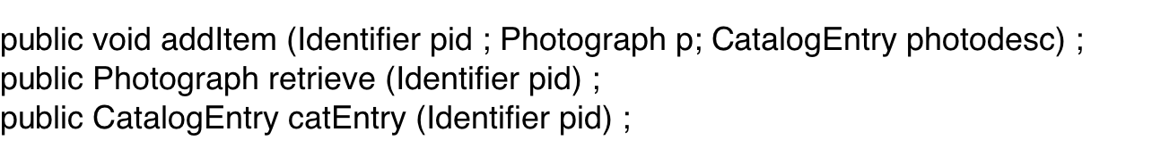
Interface semantics
You have to rely on component documentation to decide if interfaces that are syntactically compatible are actually compatible.
Consider an interface for a PhotoLibrary component:

Slide 49
Photo Library documentation
“This method adds a photograph to the library and associates the photograph identifier and catalogue descriptor with the photograph.”
“what happens if the photograph identifier is already associated with a photograph in the library?”
“is the photograph descriptor associated with the catalogue entry as well as the photograph i.e. if I delete the photograph, do I also delete the catalogue information?”

Slide 50
The Object Constraint Language
The Object Constraint Language (OCL) has been designed to define constraints that are associated with UML models.
It is based around the notion of pre and post condition specification – common to many formal methods.

Slide 51
The OCL description of the Photo Library interface
-- The context keyword names the component to which the conditions apply
context addItem
-- The preconditions specify what must be true before execution of addItem
pre: PhotoLibrary.libSize() > 0
PhotoLibrary.retrieve(pid) = null
-- The postconditions specify what is true after execution
post:libSize () = libSize()@pre + 1
PhotoLibrary.retrieve(pid) = p
PhotoLibrary.catEntry(pid) = photodesc
context delete
pre: PhotoLibrary.retrieve(pid) <> null ;
post: PhotoLibrary.retrieve(pid) = null
PhotoLibrary.catEntry(pid) = PhotoLibrary.catEntry(pid)@pre
PhotoLibrary.libSize() = libSize()@pre—1

Slide 52
Photo library conditions
As specified, the OCL associated with the Photo Library component states that:
There must not be a photograph in the library with the same identifier as the photograph to be entered;
The library must exist - assume that creating a library adds a single item to it;
Each new entry increases the size of the library by 1;
If you retrieve using the same identifier then you get back the photo that you added;
If you look up the catalogue using that identifier, then you get back the catalogue entry that you made.

Slide 53
Composition trade-offs
When composing components, you may find conflicts between functional and non-functional requirements, and conflicts between the need for rapid delivery and system evolution.
You need to make decisions such as:
What composition of components is effective for delivering the functional requirements?
What composition of components allows for future change?
What will be the emergent properties of the composed system?

Slide 54
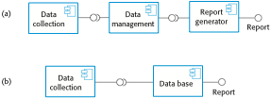
Data collection and report generation components

Slide 55
Key points
During the CBSE process, the processes of requirements engineering and system design are interleaved.
Component composition is the process of ‘wiring’ components together to create a system.
When composing reusable components, you normally have to write adaptors to reconcile different component interfaces.
When choosing compositions, you have to consider required functionality, non-functional requirements and system evolution.

